Slide 1
Personnel Security
CIS433/533
Alawya ALawami

Slide 2

Personnel Security
Personnel security is a system of policies and procedure which seek to manage the risk of staff ( permeant, temporary or contract staff) exploiting, or intending to exploit, their legitimate access to an organization assets or premises for unauthorized purposes

Slide 3
People based threats
Mistakes
Business report losing data from software vulnerability incident whilst also reporting losing dara from an accidental leak by staff
Malicious insider
The critical aspect of an attacker inside your organization is that all your perimeter defences means nothing as they are already on your network with a legitimate account
“Acts of God”
Fire, flood and explosion. Both paper and digital information could be permanently destroyed and impossible to recover or recreate

Slide 4
Insider threats
Accidental insider
Bad password
Social engineering target
Intentional insider
How to spot/stop them
Training
Good Lockdown of systems
Auditing

Slide 5
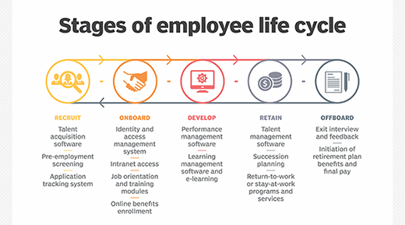
Employment life cycle

Slide 6
Background checks
Pre-employment screening
Reference check, credit check, employment history
Verify the applicant's claims
Discover criminal history, workers comp claims
Legalities vary by country
Social media analysis
GATHER DATA FROM social media
Facebook, Instagram, twitter etc
Build a personal profile

Slide 7

On boarding
Bring new person into the organization
Employee handbook
Behavior, respect, how to talk
Employment contract
It agreements need to be signed
Maybe part of the employee

Slide 8
Acceptable use policies
What is acceptable use of company assets?
Detailed document that outline the appropriate use of access to a corporate network or the internet.
The rule of behavior ( what you can/can’t do)

Slide 9
Other documents
NDA
Confidential agreement/legal contract
Preventing the unauthorized disclosure of Confidential Information
Privacy Policy
Internal (employee)
External(public)

Slide 10
User training
Gamification
Score points
Complete with others
Collect badges
Capture the flag
Security competitions
Hack into servers
Send simulated phishing emails
Make phishing calls
See which users are susceptible
Computer based training

Slide 11
Jobs rotations
Keep people moving between responsibilities
No one maintains controls of long period of time
Mandatory vacation
Rotate others through the job
The longer the vacation

Slide 12
Separation of duties
Split knowledge
No one person has all of the details
Half of a safe combination
Dual control
Two people must be present to access the information
Clean desk policy

Slide 13
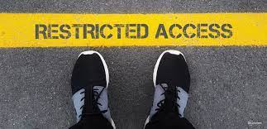
Least privilege policy
Rights and permissions should be set to minimum
All account must be limited
Even application should run with minimal privileges
Don’t allow users to run with administrative privileges
Limits the scope of malicious behavior

Slide 14
Adverse actions
An action that denies employments based on background check
Mary require extensive documentation
Can also include existing employees

Slide 15
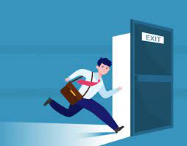
Off boarding
All good things
What happens to the hardware
What happens to the data
Account info is usually deactivated
But no always deleted
Especially not deleting any encryption keys

